Slide 1
EETS 8390: data center network engineering
M. Scott Kingsley
CHAPTER 5: Data Center Networking Standards

Slide 2
Chapter 5: Cloud Data Center Networking Standards
In this chapter, we describe several types of networking standards that are important in cloud data center networks.
We describe how the new Ethernet data rate standards have improved data center network connectivity.
We also describe the virtual local area network header, which is relevant to many other data center networking standards that are described in this book.

Slide 3
Chapter 5: Cloud Data Center Networking Standards
Next, we provide some information about data center bridging, which is key for running converged storage, and data on the same network.
We also describe standards to improve data center network bandwidth utilization.
Finally, we provide an overview of remote direct memory access as a way to improve application-to-application performance in data center networks.

Slide 4
Chapter 5: Cloud Data Center Networking Standards
Cloud data center network administrators do not want to be locked into a single network equipment vendor.
This requires networking equipment from a given vendor that can efficiently interoperate with equipment from other vendors, not only at the physical interconnect level but at the functional level.
This is why industry standard specifications for networking equipment are established.

Slide 5
Chapter 5: Cloud Data Center Networking Standards
IETF
IEEE

Slide 6
Chapter 5: Cloud Data Center Networking Standards
In this chapter, we first discuss several physical layer Ethernet standards that are used extensively within large cloud data center networks.
The next section will cover the virtual local area network (VLAN) specification that is widely used in Ethernet networks today.

Slide 7
Chapter 5: Cloud Data Center Networking Standards
We will then discuss DCB, which encompasses a key set of standards for converging storage and data traffic in the same network.
Next, various standards for optimizing data center network bandwidth will be discussed, followed by a section on standards for efficiently moving data throughout the data center.
Other standards for server virtualization, network virtualization, storage networking, and software-defined networking will be covered in later chapters of this book.

Slide 8
Ethernet data rate standards
In the 1990s and early 2000s, Ethernet was behind in the bandwidth race.
During that time Synchronous Optical Network/Synchronous Digital Hierarchy (SONET/SDH) carrier networks were running at 2.5Gbps and 10Gbps, while storage network protocols such as Fibre Channel were moving from 1Gbps to 2Gbps and 4Gbps.
At the same time, 1GbE was just coming into its own.

Slide 9
Ethernet data rate standards
It wasn’t until 2003 that companies like Intel started to develop 10GbE network controllers and 10GbE switches didn’t start appearing until around 2006.
In 2012, 10GbE shipments started ramping into high volumes, including Ethernet controllers used to connect servers to the network and top of rack switches.

Slide 10
Ethernet data rate standards
Because Ethernet now provides both low cost and high bandwidth solutions, it has become the standard transport protocol in data center networks and carrier networks, and is making strong inroads into storage networks with protocols such as Fibre Channel over Ethernet (FCoE) which will be covered in Chapter 8.

Slide 11
10GE
Because Ethernet now provides both low cost and high bandwidth solutions, it has become the standard transport protocol in data center networks and carrier networks, and is making strong inroads into storage networks with protocols such as Fibre Channel over Ethernet (FCoE) which will be covered in Chapter 8.

Slide 12
10GbE
The IEEE started working a new 10GbE specification in 2002 which has resulted in a series of new IEEE 802.3 standards.
As we mentioned above, 10GbE has been around for a while, but has finally started shipping in high volume, and it is having a large impact in cloud data center networks.

Slide 13
EETS 8390: data center network engineering
M. Scott Kingsley
Data Center Bridging

Slide 14
Data center bridging (DCB)
IEEE DCB builds on classical Ethernet's strengths, adds several crucial extensions to provide the next-generation infrastructure for data center networks, and delivers unified fabric.

Slide 15
Data center bridging (DCB)
Priority-based Flow control (PFC; IEEE 802.1 Qbb): Provides capability to manage bursty, single traffic source on a multiprotocol link.
Enhanced transmission selection (ETS; IEEE 802.1 Qaz): Enables bandwidth management between traffic types for multiprotocol links.
Congestion notification (IEEE 802.1 Qau) Addresses the problem of sustained congestion by moving corrective action to the network edge.
Data Center Bridging Exchange (DCBX) Protocol Allows autoexchange of Ethernet parameters between switches and endpoints.

Slide 16
Data Center Bridging (DCB)
As enterprise data centers evolved, separate fabrics were used for data and storage.
A server may utilize a network interface controller (NIC) for connecting to the Ethernet fabric or a host bus adapter (HBA) for connecting to the storage network.
Large data centers cannot afford to support two separate fabrics and, therefore, send both data and storage traffic across a single unified Ethernet network.

Slide 17
Data Center Bridging (DCB)
Traditional Ethernet switches have been designed to drop packets during periods of high congestion with the assumption that these packets will be retransmitted at the TCP layer.
But certain traffic types, such as video and storage, cannot tolerate the high latency variations caused by retransmission time-out values.
Because of this, the IEEE has developed several new standards that are collectively known as data center bridging (DCB).

Slide 18
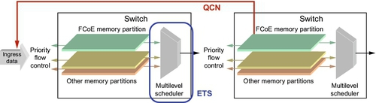
Data Center Bridging (DCB)
FIGURE 5.2 DCB overview

Slide 19
Data Center Bridging (DCB)
Figure 5.2 is a pictorial representation of a device, such as a NIC, sending ingress data into the fabric which consists of two switching stages.
Memory partitions on the switch are allocated for certain traffic classes, and, as they fill up, priority-based flow control (PFC) messages are sent to the transmitting device.

Slide 20
Data Center Bridging (DCB)
Multilevel schedulers are employed to provide minimum bandwidth guarantees using the enhanced transmission selection (ETS) protocol.
If congestion occurs somewhere within the fabric, quantized congestion notification (QCN) messages are sent back to throttle the source of the traffic.

Slide 21
Data Center Bridging (DCB)
The switches also can exchange information such as the number of traffic classes supported through the data center bridging exchange (DCBx) protocol.
In this section, we will provide more details behind each of these standards.

Slide 22
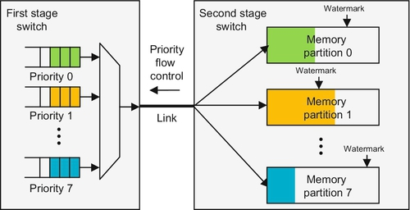
DCB Priority-Based Flow Control (PBF)
FIGURE 5.3 Priority-based flow control block diagram.

Slide 23
DCB Priority-Based Flow Control (PBF)
PBF is used to provide lossless operation for certain types of data center traffic, such as storage.
Up to eight priority levels are supported with PFC, but typical implementations may use only two or three.
In this example, the second switch stage uses traffic-class-based memory partitions with programmable watermarks.

Slide 24
DCB Priority-Based Flow Control (PBF)
If an allocated memory partition starts to fill up and a watermark is crossed, a priority flow control message is generated and sent to the transmitting switch, which then stops sending frames assigned to that particular traffic class for a specified pause time included in the frame.
Transmission is resumed when the pause time expires.
This ensures that other non-congested traffic is not paused and, therefore, remains unaffected.

Slide 25
DCB Priority-Based Flow Control (PBF)
Keep in mind that a single memory partition in a shared memory switch may be receiving data from multiple switch ports and, therefore, will need to send PFC messages to all of these ports once a watermark level is exceeded.

Slide 26
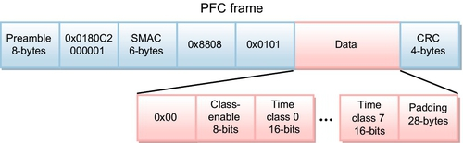
DCB Priority-Based Flow Control (PBF)
FIGURE 5.4 IEEE 802.1Qbb PFC frame format.

Slide 27
DCB Priority-Based Flow Control (PBF)
This is effectively a standard Ethernet frame but with some predefined fields and a special payload. The important fields are defined as follows:
Destination MAC address: This field is set to a specially reserved multicast address of 0x0180C2000001 in order to identify the frame as an IEEE 802.1Qbb PFC frame.
Source MAC address: This is set to the MAC address of the sending device.
Ethernet type: This is set to 0x8808 for this type of frame.

Slide 28
DCB: Priority-Based Flow Control (PBF)
Class-enable bits: These bits represent traffic classes 0–7. If a bit is set high, pause is enabled for that class.
Class time fields: For each class-enable bit that is set, these 16-bit values specify the length of time to enable pausing of the particular traffic class. A value of zero tells the sender to un-pause that particular traffic class.

Slide 29
DCB: Priority-Based Flow Control (PBF)
https://www.youtube.com/watch?v=2yv2mvSgZkY&t=174s

Slide 30
DCB: Enhanced Transmission Selection (ETS)
One way to minimize congestion for certain traffic classes is to allocate and/or limit bandwidth using schedulers and shapers similar to the ones used in traffic managers.
For applications using DCB, the IEEE developed the 802.1Qaz specification known as Enhanced Transmission Selection (ETS).
Figure 5.5 is an example of an ETS scheduler that may be found at each egress port of data center NICs or switches.

Slide 31
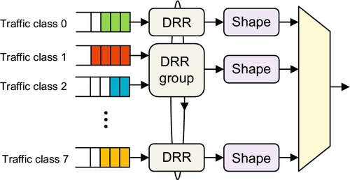
DCB: Enhanced Transmission Selection (ETS)
FIGURE 5.5 Example ETS scheduler.
DRR = Deficit Round Robin
DRR gives a minimum bandwidth guarantee to a traffic class,

Slide 32
DCB: Enhanced Transmission Selection (ETS)
Ethernet frames may be assigned to traffic classes in one of two ways.
Various frame header fields may be examined, including MAC addresses, IP addresses, and frame types, to determine to which traffic class the frame should be assigned.
This can be done using Access Control List rules which are implemented in a CAM or TCAM memory structure.
A second way is to simply examine the 3-bit PCP field in the VLAN tag. Once the frames are classified, they can be assigned to queues where bandwidth allocation and shaping are applied.

Slide 33
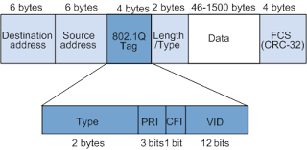
DCB: Enhanced Transmission Selection (ETS)

Slide 34
DCB: Enhanced Transmission Selection (ETS)
The following is required to be compliant with the ETS specification.
Support for at least three traffic classes.
The granularity of bandwidth allocation must be 10% or finer. For example, 20% to class 0, 40% to class 1, and 40% to class 2.
The granularity of traffic shaping must be 1% or finer.
Support for a transmission selection policy such that if one of the traffic classes does not consume its allocated bandwidth, then any unused bandwidth is available to other traffic classes.
.

Slide 35
DCB: Quantized Congestion Notification (QCN)
Even when using PFC and ETS to provide lossless operation and bandwidth guarantees, congestion hot spots can occur in these large multistage fabrics, which can cause unpredictable fabric performance.
In an attempt to minimize these congestion hot spots, the IEEE developed the QCN specification 802.1Qau.

Slide 36
DCB: Quantized Congestion Notification (QCN)
Figure 5.6 provides a high level view of how QCN operates in a layer 2 subnetwork.
The QCN congestion points are typically located in the second and third switch fabric stages and contain functions that periodically sample frames in their queues using a sample period based on recent congestion levels.

Slide 37
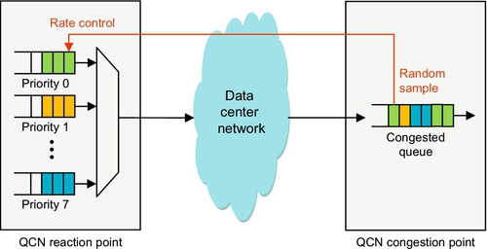
DCB: Quantized Congestion Notification (QCN)
FIGURE 5.6 QCN operation example

Slide 38
DCB: Quantized Congestion Notification (QCN)
Keep in mind that each layer 2 frame also includes a source MAC address that can be used as a return address to the traffic source. When a frame is sampled at a given sampling rate, the congestion point:
Reads the queue length from the switch
Calculates a feedback value based on the queue fill level information
Formats a special QCN frame containing the feedback value which is forwarded back to the reaction point using the source MAC address
Updates the queue sampling rate according to the dynamics specified by the QCN algorithm

Slide 39
DCB: Quantized Congestion Notification (QCN)
At the reaction point, when a special QCN frame is received from the congestion point, the feedback value is used to rate limit the appropriate ingress (source) queue.
The rate is decreased based on the feedback value, but then slowly increases again based on mechanisms described in the QCN standard until the initial rate is again achieved.
Although QCN was originally driven in the IEEE standards body by companies like Cisco, it is rarely implemented in data centers today.

Slide 40
DCB Exchange Protocol
As you can see by reading this section, the implementation of PFC and ETS require some level of coordination between neighboring devices.
For example, PFC requires that link partners understand the number of priorities, or traffic classes, that each other support.

Slide 41
DCB Exchange Protocol
In addition to the number of traffic classes, ETS also needs to know the type of bandwidth granularity and shaping granularity that each switch can support in order to provide consistent operation across the network.

Slide 42
DCB Exchange Protocol
DCBx protocol uses the IEEE 802.1AB standard to exchange capabilities and configuration information of DCB features between neighboring devices in order to provide consistent operation across the data center network.
With DCBx, link-level discovery protocol (LLDP) Ethernet frames are sent at a periodic rate between link partners that contain the information necessary to properly configure a DCB capable device.

